Slide 1
Unit 5 :
Performing advanced queries
Session 5
Databases

Slide 2
SUBQUERIES

Slide 3
Subqueries
A subquery is a SELECT query that is made within another SELECT query. The data that is obtained from the subquery is used in the query in which it is included.
Subqueries can also be used within INSERT, UPDATE, and DELETE statements.
If subqueries did not exist, to obtain the license plates, makes, models and rental prices of cars that have a rental price higher than the car with registration number 5031JHL, we would possibly pose this with two instructions;
1.- Obtain the rental price of the car with registration number 5031JHL
SELECT price FROM cars WHERE license plate='5031JHL';
2.- Obtain now the license plates, brands, models and prices of cars with a rental price greater than 116.45 Euros.
SELECT license plate, make, model, price FROM cars WHERE price > 116.45;

Slide 4
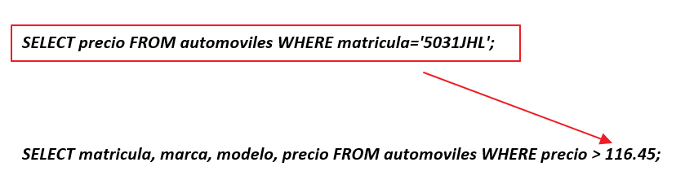
Subqueries
In the previous example, what we have actually done is this:
We can modify the second statement so that, instead of the price, it uses a subquery to obtain the price of the car with the indicated license plate.
SELECT registration, make, model FROM cars WHERE price >(SELECT price FROM cars WHERE registration = '5031JHL') ;

Slide 5
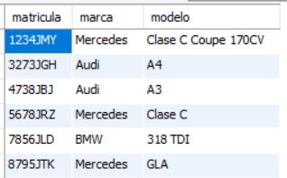
Subqueries
Example: Obtain the license plates, makes, models and rental prices of cars that have a rental price higher than the car with registration number 5031JHL.
SELECT registration, make, model FROM cars WHERE price>(SELECT price FROM cars WHERE registration = '5031JHL') ;
VERY IMPORTANT: In subqueries like this one above, which are used to compare with a value, the subqueries must return only one value

Slide 6

Subqueries
Example: Obtain the license plates, makes, models and rental prices of red cars that have a rental price higher than the car with registration number 5031JHL.
SELECT license plate, make, model FROM cars WHERE price>(SELECT price FROM cars WHERE license plate = '5031JHL') AND color='red';

Slide 7
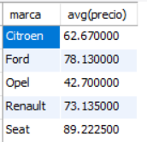
Subqueries
Example: Obtain the brands and their average rental prices as long as this average price is lower than the rental price of the car with registration number 5031JHL.
SELECT brand, avg(price) FROM cars GROUP BY brand HAVING avg(price) < (SELECT price FROM cars WHERE license plate = '5031JHL');

Slide 8

Subqueries
Example: Get the make and model of the highest rental car.
SELECT make,model,price FROM cars WHERE price = (SELECT max(price) FROM cars);

Slide 9

Subqueries
Example: Obtain the make and model of the car corresponding to contract number 10.
SELECT make, model FROM cars WHERE registration = (SELECT registration FROM contracts WHERE contractnum=10);
But this can be done in the following way, and it is more suitable, since the query consumes less time. In general, statements that use subqueries take longer than those that do not, although this is not always the case.
SELECT make, model FROM automobiles INNER JOIN contracts USING (registration) WHERE contractnum=10;

Slide 10
Subqueries
UNION:
UNION is used to combine the results of multiple statements into a single result set.
The columns in the results of both queries must be of the same type. The final result will have the column names of the first query.
By default it only shows rows that are different (as if we put the DISTINCT clause). We can avoid this with the ALL clause.
Example: Obtain the ID of the clients from the contracts table and the contracts2 table.
SELECT DISTINCT dniclient FROM contracts UNION ALL SELECT DISTINCT dniclient FROM contracts2;
The result will be a table with the IDs of the clients of both tables. If there are clients with contracts in both tables, they will appear twice.
Example: Obtain the license plate of currently rented cars (ffin=NULL) and Renault brand cars without repeating license plates.
SELECT license plate FROM contracts WHERE ffin IS NULL UNION SELECT license plate FROM automobiles WHERE brand="Renault";

Slide 11

Subqueries
So far we have used subqueries within WHERE and HAVING clauses. They can also be used in the FROM clause to obtain a results sheet from which we construct a query.
Example: Obtain the data of the clients that have contracts in the two contract tables (contracts and contracts 2).
SELECT * FROM clients INNER JOIN (SELECT DISTINCT dniclient FROM contracts UNION ALL SELECT DISTINCT dniclient FROM contracts2) AS t ON t.dniclient=clients.dni GROUP BY dni HAVING count(*)=2;

Slide 12

Subqueries
ligatercera database , obtain how many teams have scored goals on matchday 1.
What we are going to do is a subquery with the union of counting how many local teams have scored goals and how many visiting teams have scored goals. We renamed that union to treat it as if it were a table. From that table, we add the values it contains, that is, the local teams that have scored goals and the visitors that have scored goals.
SELECT sum (they scored) FROM ( SELECT count (*) AS they scored FROM matches WHERE goalsloc >0 AND nummatch =1 UNION ALL SELECT count (*) AS they scored FROM matches WHERE goalsvis >0 AND nummatch =1 ) AS t;

Slide 13
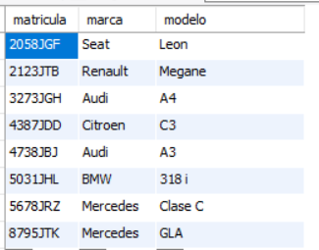
Subqueries
Check if a data item is included in multiple values returned by a subquery
You cannot use the equality operator (=) or other relational operators to compare with subqueries that return more than one value. If we want to check that a value is included within the set of values returned by the subquery, we will use the IN operator.
Example: Obtain the license plates, makes and models of cars rented since January 1, 2018.
SELECT license plate, make, model FROM automobiles WHERE license plate IN (SELECT license plate FROM contracts WHERE fini>='2018-01-01');

Slide 14

Subqueries
Example: Obtain the make and model of all the cars that Ismael Poza Rincón has rented.
SELECT brand, model FROM automobiles WHERE registration IN (SELECT registration FROM contracts WHERE dniclient = (SELECT dni FROM clients WHERE name='Ismael' AND surname='Poza Rincón'));

Slide 15
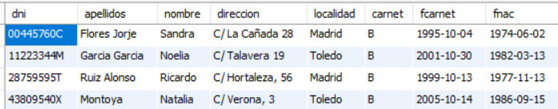
Subqueries
Example: Obtain data from clients who have not made any contract.
SELECT * FROM clients WHERE dni NOT IN (SELECT DISTINCT dniclient FROM contracts);

Slide 16

Subqueries
Using the ALL quantifier
In subqueries that return multiple values, the ALL quantifier allows you to select rows that meet a certain condition with respect to all the values returned by the subquery .
That is, the ALL operator selects values if all subquery records meet the condition.
Example: Obtain the car brands for which no car has been rented in 2018.
SELECT brand FROM automobiles where brand <> ALL (SELECT DISTINCT brand FROM contracts INNER JOIN automobiles USING (registration) WHERE year ( fini )=2018);

Slide 17
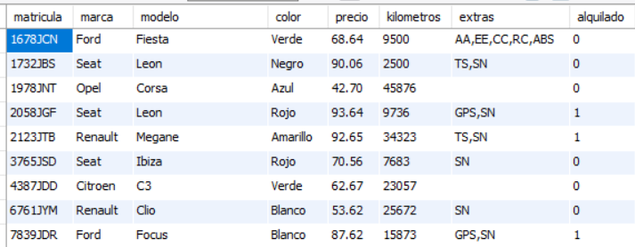
Subqueries
Using the ANY quantifier
In subqueries that return multiple values, the ANY quantifier allows you to select rows that meet a certain condition for at least one of the values returned by the subquery .
That is, the ANY operator returns true if any of the subquery values meet the condition.
Example: Obtain the data of cars with a rental price lower than that of any of the SEAT cars.
SELECT * FROM cars WHERE price < ANY (SELECT price FROM cars WHERE brand=' seat ');

